Slide 1

CSE430:Digital Signal Processing
DT SIGNALS AND SYSTEMS (CORRELATION)
Acknowledgement for lecture slides – Dr. Mohammad Zavid Parvez

Slide 2
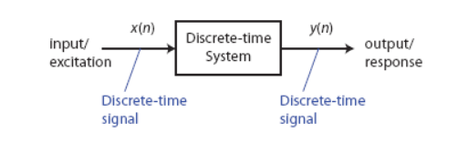
Terminology: Input-Output Description

Slide 3
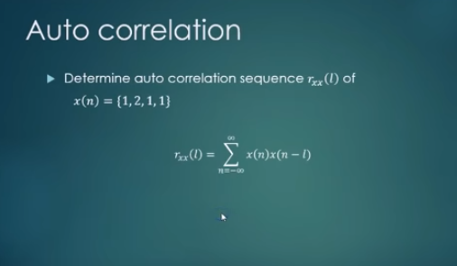
Auto-Correlation

Slide 4
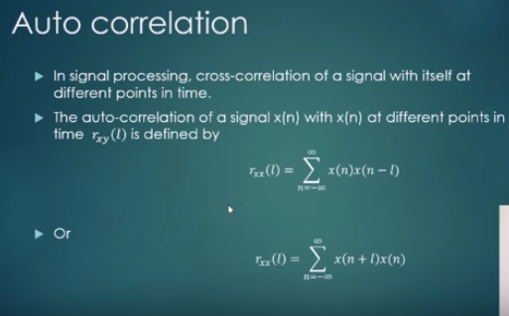
Auto-Correlation

Slide 5
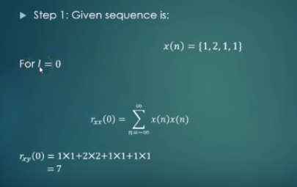
Auto-Correlation

Slide 6
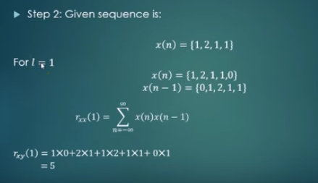
Auto-Correlation

Slide 7
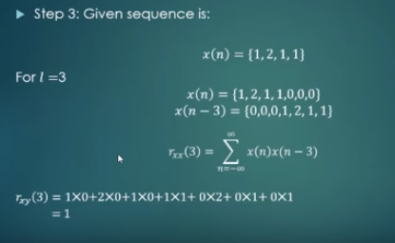
Auto-Correlation

Slide 8
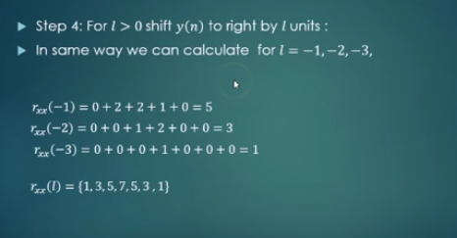
Auto-Correlation

Slide 9
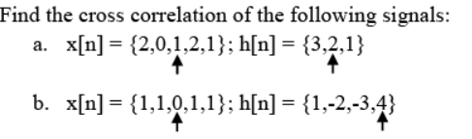
Cross-correlation

Slide 10
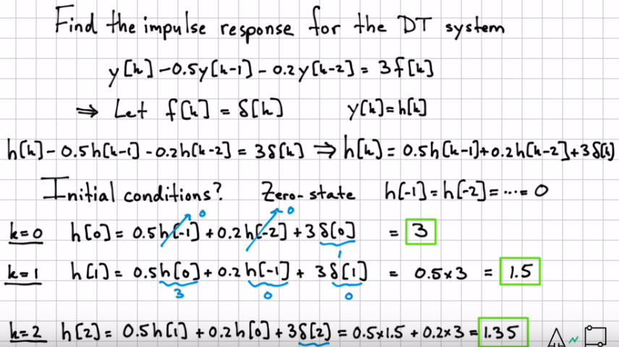
Impulse Response of the DT System

